Slide 1
Coin changing

Slide 2
Coin changing problem
Consider the problem of making change for n cents using the fewest number of coins. Assume that each coin’s value is an integer.

Slide 3
Coin changing problem
a. Describe a greedy algorithm to make change consisting of quarters (25 cents), dimes (10 cents), nickels (5 cents), and pennies (1 cent). Prove that your algorithm yields an optimal solution.
A greedy algorithm to make change using quarters, dimes, nickels, and pennies works as follows:
Give q =⎿n/25⏌quarters. That leaves n_{q} = n mod 25 cents to make change.
Then give d =⎿n_{q}/10⏌dimes. That leaves n_{d} = n_{q} mod 10 cents to make change.
Then give k =⎿n_{d}/5⏌nickels. That leaves n_{k} = n_{d} mod 5 cents to make change.
Finally, give p = n_{k} pennies.

Slide 4
A greedy algorithm
b. Suppose that the available coins are in the denominations (面值) that are powers of c, i.e., the denominations are c⁰, c¹, . . . , c^{k} for some integers c > 1 and k ≥ 1. Show that the greedy algorithm always yields an optimal solution.
When the coin denominations are c⁰, c¹, . . . , c^{k}, the greedy algorithm to make change for n cents works by finding the denomination c^{j} such that j = max{0 ≤ i ≤ k : c^{i} ≤ n}, giving one coin of denomination c^{j}, and recursing on the subproblem of making change for n − c^{j} cents. (An equivalent, but more efficient, algorithm is to give⎿n/c^{k}⏌coins of denomination c^{k} and⎿(n mod c^{i+1})/c^{i}⏌coins of denomination c^{i} for i = 0, 1, . . . , k −1.) To show that the greedy algorithm produces an optimal solution, we start by proving the following lemma:

Slide 5
A greedy algorithm
remainder = n;
for i = k downto 0
a[i] =⎿ remainder/c^{i}⏌
remainder = remainder mod c^{i}
for i = 0 to k − 1
a[i] =⎿(n mod c^{i+1})/c^{i}⏌
a[k] =⎿n/c^{k}⏌

Slide 6
An example for which the greedy algorithm does not yield an optimal solution
c. Give a set of coin denominations for which the greedy algorithm does not yield an optimal solution. Your set should include a penny so that there is a solution for every value of n.
With actual U.S. coins, we can use coins of denomination 1, 10, and 25. When n = 30 cents, the greedy solution gives one quarter and five pennies, for a total of six coins. The non-greedy solution of three dimes is better.
The smallest integer numbers we can use are 1, 3, and 4. When n = 6 cents, the greedy solution gives one 4-cent coin and two 1-cent coins, for a total of three coins. The non-greedy solution of two 3-cent coins is better.

Slide 7
A dynamic programming algorithm
d. Give an O(nk)-time algorithm that makes change for any set of k different coin denominations, assuming that one of the coins is a penny.

Slide 8
A dynamic programming algorithm
d. Give an O(nk)-time algorithm that makes change for any set of k different coin denominations, assuming that one of the coins is a penny.
Let us define c[ j] to be the minimum number of coins we need to make change for j cents. Let the coin denominations be d₁, d₂, . . ., d_{k}. Since one of the coins is a penny, there is a way to make change for any amount j ≥ 1.

Slide 9
A dynamic programming algorithm
d. Give an O(nk)-time algorithm that makes change for any set of k different coin denominations, assuming that one of the coins is a penny.
Let us define c[ j] to be the minimum number of coins we need to make change for j cents. Let the coin denominations be d₁, d₂, . . ., d_{k}. Since one of the coins is a penny, there is a way to make change for any amount j ≥ 1.
Because of the optimal substructure, if we knew that an optimal solution for the problem of making change for j cents used a coin of denomination d_{i}, we would have c[ j] = 1 + c[ j − d_{i}]. As base cases, we have that c[ j] = 0 for all j ≤ 0.

Slide 10
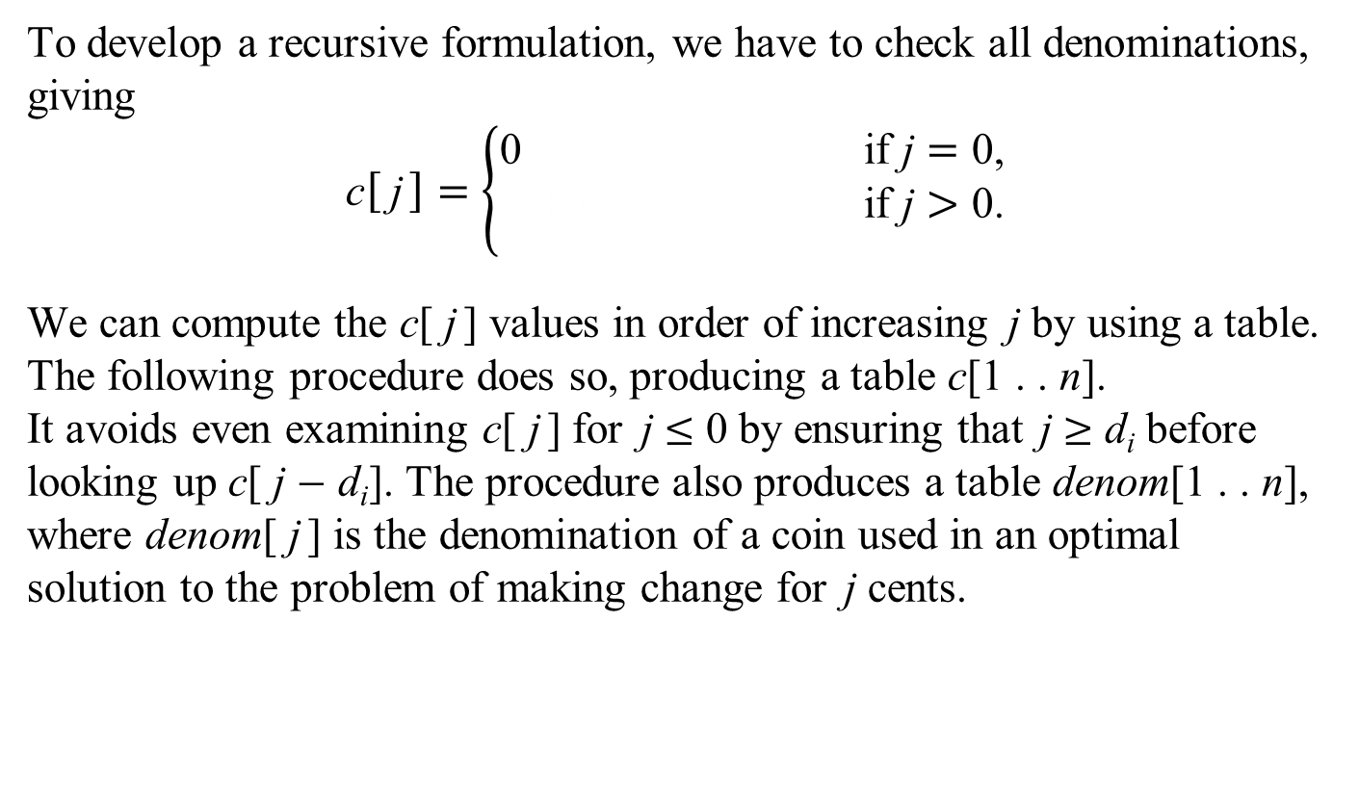
A dynamic programming algorithm
To develop a recursive formulation, we have to check all denominations, giving
$$\text{c}\left[ \text{j}\right]=\left\{\begin{matrix}\text{0} & \text{if} \text{j}=\text{0,} \\ \text{1}+\min_{d_{i}≤j}{\text{c}\text{[ }\text{j}−\text{d}\text{i}\text{]}} & \text{if} \text{j}>\text{0}\text{.}\end{matrix}\right.$$
We can compute the c[ j] values in order of increasing j by using a table. The following procedure does so, producing a table c[1 . . n]. It avoids even examining c[ j] for j ≤ 0 by ensuring that j ≥ d_{i} before looking up c[ j − d_{i}]. The procedure also produces a table denom[1 . . n], where denom[ j] is the denomination of a coin used in an optimal solution to the problem of making change for j cents.

Slide 11
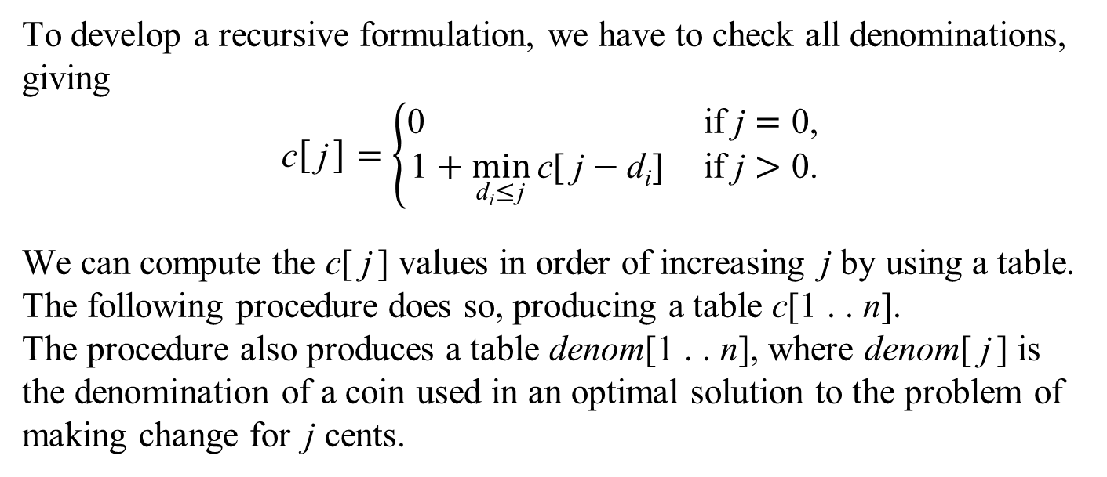
A dynamic programming algorithm
To develop a recursive formulation, we have to check all denominations, giving
$$\text{c}\left[ \text{j}\right]=\left\{\begin{matrix}\text{0} & \text{if} \text{j}=\text{0,} \\ \text{1}+\min_{\text{d}\text{i}\text{≤}\text{j}}{\text{c}\text{[ }\text{j}−\text{d}\text{i}\text{]}} & \text{if} \text{j}>\text{0}\text{.}\end{matrix}\right.$$
We can compute the c[ j] values in order of increasing j by using a table. The following procedure does so, producing a table c[1 . . n]. The procedure also produces a table denom[1 . . n], where denom[ j] is the denomination of a coin used in an optimal solution to the problem of making change for j cents.

Slide 12
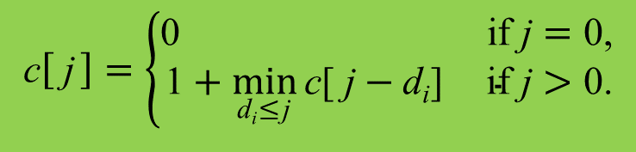
A dynamic programming algorithm
COMPUTE-CHANGE(n, d, k)
c[0] = 0
for j = 1 to n
c[ j] = ∞
for i = 1 to k
if d_{i} ≤ j and c[ j] > 1 + c[ j − d_{i}]
c[ j] = 1 + c[ j − d_{i}]
denom[ j] = d_{i}
return c and denom
This procedure obviously runs in O(nk) time.
$$\text{c}\left[ \text{j}\right]=\left\{\begin{matrix}\text{0} & \text{if} \text{j}=\text{0,} \\ \text{1}+\min_{\text{d}\text{i}\text{≤}\text{j}}{\text{c}\text{[ }\text{j}−\text{d}\text{i}\text{]}} & \text{if} \text{j}>\text{0.}\end{matrix}\right.$$

Slide 13
Let n = 6,
k = 3, d₁ = 1, d₂ = 3, d₃ = 4.
COMPUTE-CHANGE(n, d, k)
c[0] = 0
for j = 1 to n
c[ j] = ∞
for i = 1 to k
if d_{i} ≤ j and c[ j] > 1 + c[ j − d_{i}]
c[ j] = 1 + c[ j − d_{i}]
denom[ j] = d_{i}
return c and denom
 | 0 | 1 | 2 | 3 | 4 | 5 | 6
c | 0

Slide 14
Let n = 6,
k = 3, d₁ = 1, d₂ = 3, d₃ = 4.
COMPUTE-CHANGE(n, d, k)
c[0] = 0
for j = 1 to n
c[ j] = ∞
for i = 1 to k
if d_{i} ≤ j and c[ j] > 1 + c[ j − d_{i}]
c[ j] = 1 + c[ j − d_{i}]
denom[ j] = d_{i}
return c and denom
 | 0 | 1 | 2 | 3 | 4 | 5 | 6
c | 0 | 1

Slide 15
Let n = 6,
k = 3, d₁ = 1, d₂ = 3, d₃ = 4.
COMPUTE-CHANGE(n, d, k)
c[0] = 0
for j = 1 to n
c[ j] = ∞
for i = 1 to k
if d_{i} ≤ j and c[ j] > 1 + c[ j − d_{i}]
c[ j] = 1 + c[ j − d_{i}]
denom[ j] = d_{i}
return c and denom
 | 0 | 1 | 2 | 3 | 4 | 5 | 6
c | 0 | 1 | 2

Slide 16
Let n = 6,
k = 3, d₁ = 1, d₂ = 3, d₃ = 4.
COMPUTE-CHANGE(n, d, k)
c[0] = 0
for j = 1 to n
c[ j] = ∞
for i = 1 to k
if d_{i} ≤ j and c[ j] > 1 + c[ j − d_{i}]
c[ j] = 1 + c[ j − d_{i}]
denom[ j] = d_{i}
return c and denom
 | 0 | 1 | 2 | 3 | 4 | 5 | 6
c | 0 | 1 | 2 | 3

Slide 17
Let n = 6,
k = 3, d₁ = 1, d₂ = 3, d₃ = 4.
COMPUTE-CHANGE(n, d, k)
c[0] = 0
for j = 1 to n
c[ j] = ∞
for i = 1 to k
if d_{i} ≤ j and c[ j] > 1 + c[ j − d_{i}]
c[ j] = 1 + c[ j − d_{i}]
denom[ j] = d_{i}
return c and denom
 | 0 | 1 | 2 | 3 | 4 | 5 | 6
c | 0 | 1 | 2 | 1

Slide 18
Let n = 6,
k = 3, d₁ = 1, d₂ = 3, d₃ = 4.
COMPUTE-CHANGE(n, d, k)
c[0] = 0
for j = 1 to n
c[ j] = ∞
for i = 1 to k
if d_{i} ≤ j and c[ j] > 1 + c[ j − d_{i}]
c[ j] = 1 + c[ j − d_{i}]
denom[ j] = d_{i}
return c and denom
 | 0 | 1 | 2 | 3 | 4 | 5 | 6
c | 0 | 1 | 2 | 1 | 2

Slide 19
Let n = 6,
k = 3, d₁ = 1, d₂ = 3, d₃ = 4.
COMPUTE-CHANGE(n, d, k)
c[0] = 0
for j = 1 to n
c[ j] = ∞
for i = 1 to k
if d_{i} ≤ j and c[ j] > 1 + c[ j − d_{i}]
c[ j] = 1 + c[ j − d_{i}]
denom[ j] = d_{i}
return c and denom
 | 0 | 1 | 2 | 3 | 4 | 5 | 6
c | 0 | 1 | 2 | 1 | 1

Slide 20
Let n = 6,
k = 3, d₁ = 1, d₂ = 3, d₃ = 4.
COMPUTE-CHANGE(n, d, k)
c[0] = 0
for j = 1 to n
c[ j] = ∞
for i = 1 to k
if d_{i} ≤ j and c[ j] > 1 + c[ j − d_{i}]
c[ j] = 1 + c[ j − d_{i}]
denom[ j] = d_{i}
return c and denom
 | 0 | 1 | 2 | 3 | 4 | 5 | 6
c | 0 | 1 | 2 | 1 | 1 | 2

Slide 21
Let n = 6,
k = 3, d₁ = 1, d₂ = 3, d₃ = 4.
COMPUTE-CHANGE(n, d, k)
c[0] = 0
for j = 1 to n
c[ j] = ∞
for i = 1 to k
if d_{i} ≤ j and c[ j] > 1 + c[ j − d_{i}]
c[ j] = 1 + c[ j − d_{i}]
denom[ j] = d_{i}
return c and denom
 | 0 | 1 | 2 | 3 | 4 | 5 | 6
c | 0 | 1 | 2 | 1 | 1 | 2 | 3

Slide 22
Let n = 6,
k = 3, d₁ = 1, d₂ = 3, d₃ = 4.
COMPUTE-CHANGE(n, d, k)
c[0] = 0
for j = 1 to n
c[ j] = ∞
for i = 1 to k
if d_{i} ≤ j and c[ j] > 1 + c[ j − d_{i}]
c[ j] = 1 + c[ j − d_{i}]
denom[ j] = d_{i}
return c and denom
 | 0 | 1 | 2 | 3 | 4 | 5 | 6
c | 0 | 1 | 2 | 1 | 1 | 2 | 2

Slide 23
A dynamic programming algorithm
We use the following procedure to output the coins used in the optimal solution computed by COMPUTE-CHANGE:
GIVE-CHANGE( j, denom)
if j > 0
give one coin of denomination denom[ j]
GIVE-CHANGE( j − denom[ j], denom)
The initial call is GIVE-CHANGE(n, denom). Since the value of the first parameter decreases in each recursive call, this procedure runs in O(n) time.

